Slide 1

Hospital Management System
DONE BY, M.MITHESH (AP22110010195)
P.KRANTHI(AP22110010146)
P.ANUJ KUMAR(AP22110010165)
A.SOMANADAH SAI(AP22110010197)
B.GANESH(AP22110011532)

Slide 2
HOSPITAL MANAGEMENT SYSTEM Overview
A comprehensive hospital management system streamlines patient care, optimizes resources, and enhances operational efficiency. This system integrates various modules to manage patient data, doctor information, room availability, and billing, while providing analytical insights to improve overall healthcare delivery.

Slide 3
INTRODUCTION:
The project on Hospital Management System is designed to optimize healthcare administration and enhance patient care delivery. The system comprises modules for Doctor Management, Patient Management, Patient Treatment, Room Assignments. It encompasses various entities crucial to the hospital managing domain. Doctor Management facilitates efficient tracking and record-keeping through and essential attributes. Similarly, Patient Management ensures streamlined handling of patient data. The Billing System transparently generates invoices for medical services and accommodation, enhancing financial transparency within the healthcare facility. Room Assignments are made based on medical needs, ensuring seamless coordination and enhancing patient comfort throughout their stay. The system also includes comprehensive patient records, appointment scheduling.

Slide 4
Patient Registration and Records
Patient Data
Appointment Scheduling
Electronic Medical Records
The system captures essential patient information such as name, age, area of treatment, phone number, gender, patient ID, and email.
Patients can book appointments and view available slots, enabling efficient resource allocation and patient flow management.
The system maintains comprehensive electronic medical records, ensuring secure storage and easy access to patient history and test results.

Slide 5

Doctor Data Management
Doctor Profiles
Appointment Scheduling
Charge Management
The system stores details about doctors, including their area of treatment, qualification, and unique doctor ID.
Doctors can view their schedules and manage appointments, facilitating seamless patient-doctor interactions.
The system tracks doctor charges, ensuring accurate billing and financial management.

Slide 6




Room Data Management
Room Inventory
Availability Tracking
Maintenance Scheduling
The system maintains a comprehensive inventory of hospital rooms, including room type, capacity, and associated charges.
The system monitors room occupancy and availability, enabling efficient bed management and patient placement.
The system schedules room maintenance and cleaning, ensuring a safe and hygienic environment for patients.

Slide 7
Billing and Financial Management
Bill Number
Patient Details
Total Charges
ABC123
Ganesh, Room 201
2,00,000
DEF456
Bhuvan, Surgery
50,000
GHI789
Anuj, Outpatient
75,000

Slide 8
Analytics and Reporting
1
Patient Trends
Analyze patient demographics, treatment patterns, and satisfaction levels to improve service quality.
2
Resource Utilization
Monitor the utilization of hospital resources, such as beds, equipment, and staff, to optimize operational efficiency.
3
Financial Performance
Generate detailed reports on revenue, expenses, and profitability to make informed financial decisions.

Slide 9
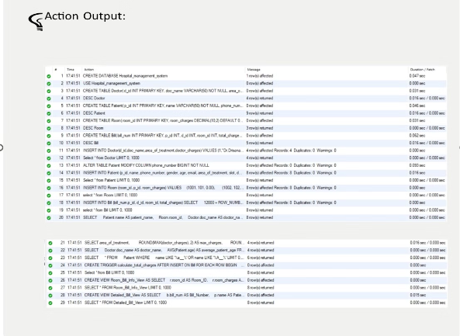
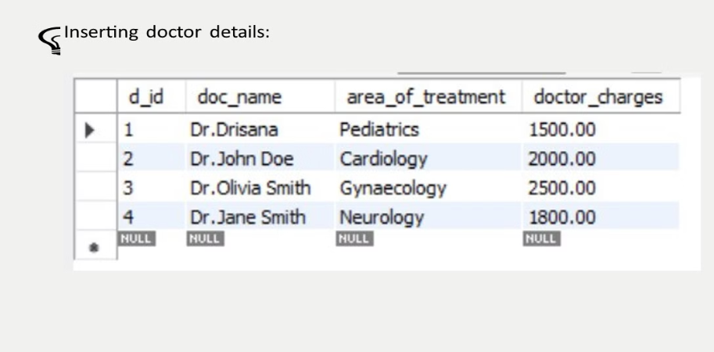
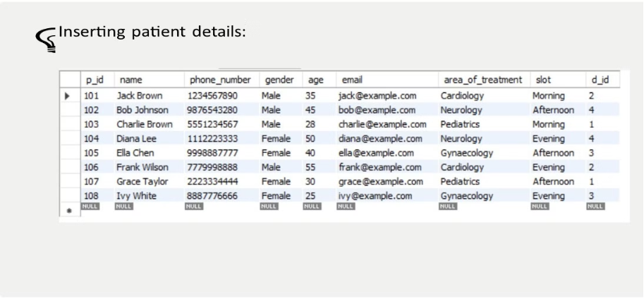
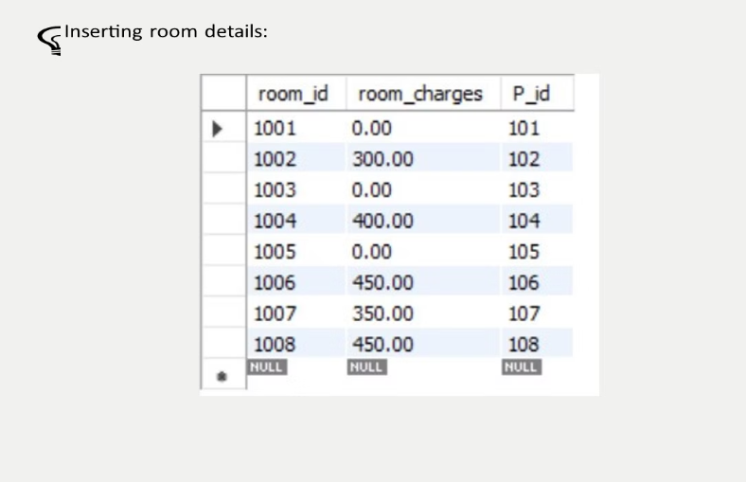
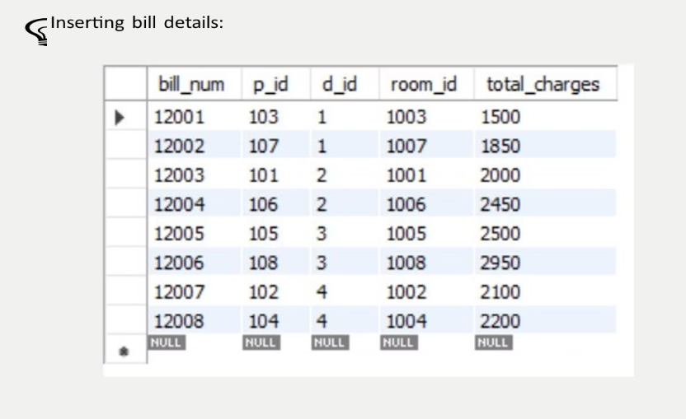
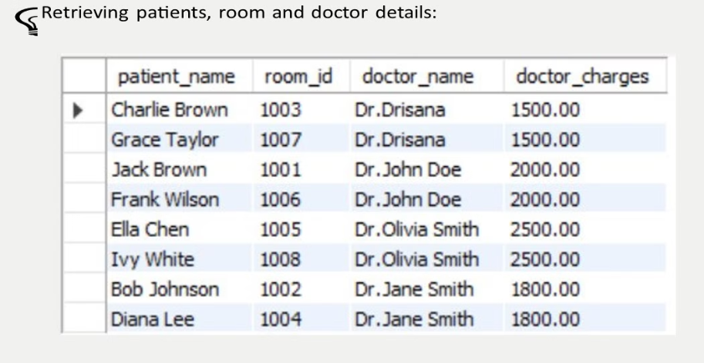
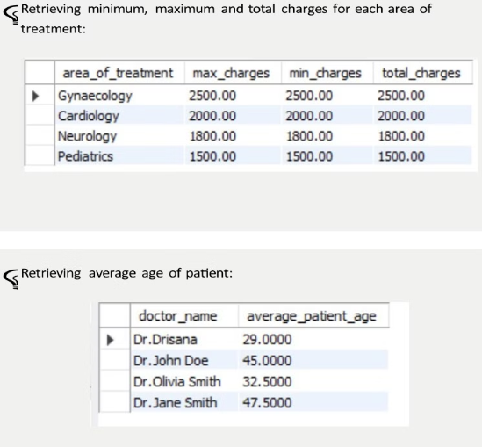
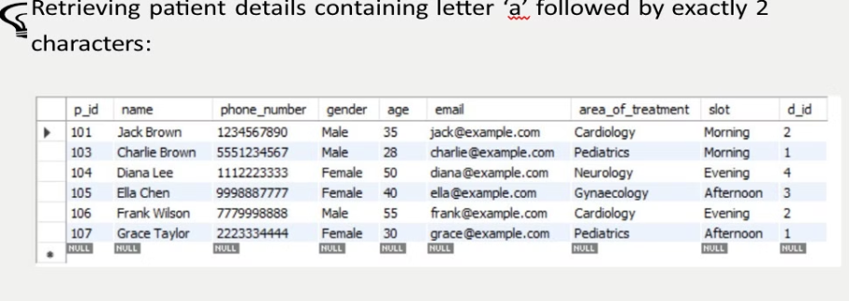
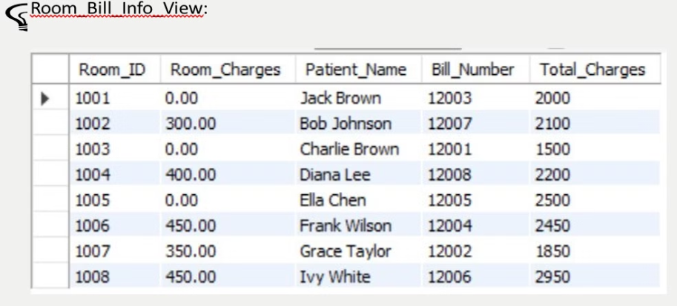
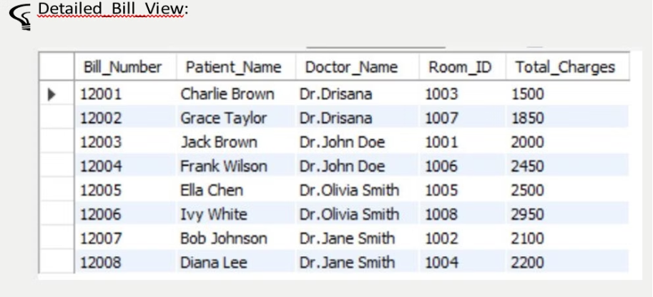
OUTPUTS:

Slide 10
CONCLUSION:
In conclusion, the integration of a Database Management System (DBMS) in hospital management systems revolutionizes healthcare administration by centralizing and organizing vast amounts of critical data efficiently. DBMS ensures data integrity, accessibility, and security, essential for maintaining patient confidentiality and regulatory compliance. Through streamlined data management processes, hospitals can optimize resource allocation, enhance decision-making, and improve overall operational efficiency. Real-time access to patient records and administrative information enables healthcare professionals to deliver timely and personalized care. Moreover, DBMS facilitates seamless communication among hospital staff, fostering collaboration and coordination across departments. However, successful implementation requires robust infrastructure, comprehensive training, and ongoing maintenance to ensure system reliability and user satisfaction. Despite challenges, DBMS in hospital management systems represents a cornerstone in modern healthcare, driving innovation, and ultimately, improving patient outcomes.

